Slide 1
DMA

Slide 2
OVERVIEW
Introduction
Implementing DMA in a computer system
Data transfer using DMA controller
Internal configuration of a DMA controller
Process of DMA transfer
DMA transfer modes

Slide 3
Direct Memory Access
Introduction
  An important aspect governing the Computer System performance is the transfer of data between memory and I/O devices.
  The operation involves loading programs or data files from disk into memory, saving file on disk, and accessing virtual memory pages on any secondary storage medium.

Slide 4
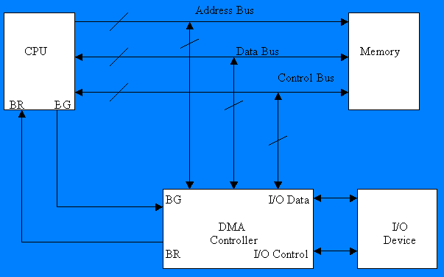
Computer System with DMA

Slide 5
DIRECT MEMORY ACCESS
Block diagram of DMA controller
Address bus
Data bus
Data bus
Address bus
buffers
buffers
DMA select
DS
Address register
Register select
RS
Internal Bus
Read
RD
Word count register
Write
WR
Control
logic
Control register
Bus request
BR
Bus grant
BG
Interrupt
Interrupt
DMA request
DMA acknowledge
to I/O device

Slide 6
Consider a typical system consisting of a CPU, memory and one or more input/output devices as shown in fig. Assume one of the I/O devices is a disk drive and that the computer must load a program from this drive into memory.
The CPU would read the first byte of the program and then write that byte to memory. Then it would do the same for the second byte, until it had loaded the entire program into memory.

Slide 7
This process proves to be inefficient. Loading data into, and then writing data out of the CPU significantly slows down the transfer. The CPU does not modify the data at all, so it only serves as an additional stop for data on the way to it’s final destinaion.
The process would be much quicker if we could bypass the CPU & transfer data directly from the I/O device to memory.
Direct Memory Access does exactly that.

Slide 8
Implementing DMA in a Computer System
A DMA controller implements direct memory access in a computer system.
It connects directly to the I/O device at one end and to the system buses at the other end. It also interacts with the CPU, both via the system buses and two new direct connections.
It is sometimes referred to as a channel. In an alternate configuration, the DMA controller may be incorporated directly into the I/O device.

Slide 9
Data Transfer using DMA Controller
To transfer data from an I/O device to memory, the DMA controller first sends a Bus Request to the CPU by setting BR to 1. When it is ready to grant this request, the CPU sets it’s Bus grant signal, BG to 1.
The CPU also tri-states it’s address,data, and control lines thus truly granting control of the system buses to the DMA controller.
The CPU will continue to tri-state it’s outputs as long as BR is asserted.

Slide 10
Internal Configuration
The DMA controller includes several registers :-
  The DMA Address Register contains the memory address to be used in the data transfer. The CPU treats this signal as one or more output ports.
  The DMA Count Register, also called Word Count Register, contains the no. of bytes of data to be transferred. Like the DMA address register, it too is treated as an O/P port (with a diff. Address) by the CPU.
  The DMA Control Register accepts commands from the CPU. It is also treated as an O/P port by the CPU.

Slide 11
Although not shown in this fig., most DMA controllers also have a Status Register. This register supplies information to the CPU, which accesses it as an I/P port.

Slide 12
DMA TRANSFER
Interrupt
BG
Random-access
CPU
memory unit (RAM)
BR
RD
WR
Addr
Data
RD
WR
Addr
Data
Read control
Write control
Data bus
Address bus
Address
select
RD
WR
Addr
Data
DS
DMA ack.
RS
DMA
I/O
BR
Controller
Peripheral
device
BG
DMA request
Interrupt

Slide 13
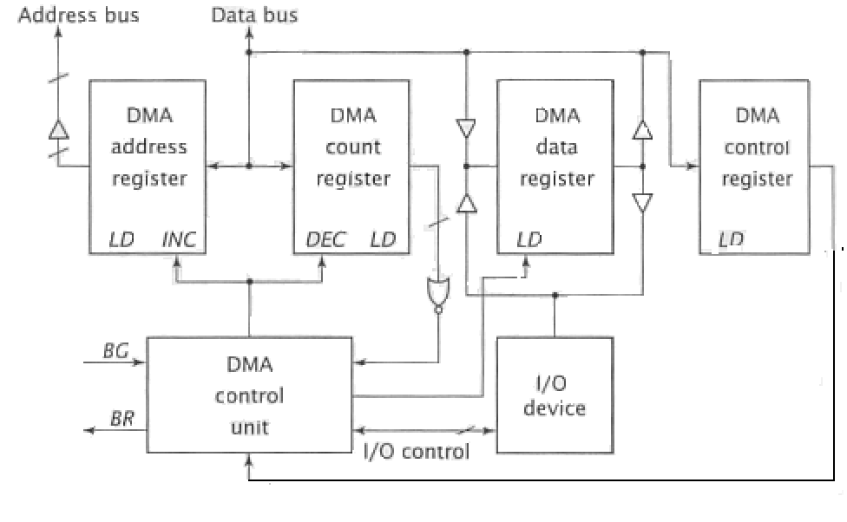
Internal Configuration of DMA Controller

Slide 14
Process of DMA Transfer
To initiate a DMA transfer, the CPU loads the address of the first memory location of the memory block (to be read or written from) into the DMA address register. It does this via an I/O output instruction.
It then writes the no. of bytes to be transferred into the DMA count register in the same manner.
Finally, it writes one or more commands to the DMA control register.

Slide 15
These commands may specify transfer options such as the DMA transfer mode, but should always specify the direction of the transfer, either from I/O to memory or from memory to I/O.
The last command causes the DMA controller to initiate the transfer. The controller then sets BR to 1 and, once BG becomes 1 , seizes control of the system buses.

Slide 16
DMA Transfer Modes
Modes vary by how the DMA controller determines when to transfer data, but the actual data transfer process is the same for all the modes.
BURST mode/Block transfer mode/ Idle mode
  An entire block of data is transferred in one contiguous sequence. Once the DMA controller is granted access to the system buses by the CPU, it transfers all bytes of data in the data block before releasing control of the system buses back to the CPU.
  This mode is useful for loading programs or data files into memory, but it does render the CPU inactive for relatively long periods of time.

Slide 17
Cycle stealing Mode/Single byte transfer mode
  Viable alternative for systems in which the CPU should not be disabled for the length of time needed for Burst transfer modes.
  DMA controller obtains access to the system buses as in burst mode, using BR & BG signals. However, it transfers one byte of data and then returning control of the system buses to the CPU by BR=0.
  DMAC and CPU are constantly stealing the bus cycles from each other.
  It continually issues requests via BR, transferring one byte of data per request, until it has transferred it’s entire block of data.

Slide 18
  By continually obtaining and releasing control of the system buses, the DMA controller essentially interleaves instruction & data transfers. The CPU processes an instruction, then the DMA controller transfers a data value, and so on.
  The data block is not transferred as quickly as in burst mode, but the CPU is not idled for as long as in that mode.
  Useful for controllers monitoring data in real time.

Slide 19
Transparent Mode:
  This requires the most time to transfer a block of data, yet it is also the most efficient in terms of overall system performance.
  The DMA controller only transfers data when the CPU is performing operations that do not use the system buses.
  For example, the Relatively simple CPU has several states that move or process data solely within the CPU:
  NOP (No operation)
  MOV A, B data transfer between CPU registers
  ADD B,C arithmetic operation, both the operands are CPU registers

Slide 20
  Primary advantage is that CPU never stops executing its programs and DMA transfer is free in terms of time.
  Disadvantage is that the hardware needed to determine when the CPU is not using the system buses can be quite complex and relatively expensive.

Slide 21
Demand transfer mode:
  Data transfer occurred only on the demand of peripheral device.
  It is similar to the Block transfer, except that the DMAr must remain active throughout the DMA operation.
  If during the operation DMAR goes low, the DMA operation will be stopped and bus control will be back with CPU.
  Once DMAR goes high again, the DMA operation continues from where it had stopped.
  When dreq=1, data transfer will be performed
  When dreq=0, CPU will be the bus master.

Slide 22
Summary
Advantages of DMA
  Computer system performance is improved by direct transfer of data between memory and I/O devices, bypassing the CPU.
  CPU is free to perform operations that do not use system buses.
Disadvantages of DMA
  In case of Burst Mode data transfer, the CPU is rendered inactive for relatively long periods of time.

